Slide 1

Project 4
Prediction of Heart Attack

Slide 2
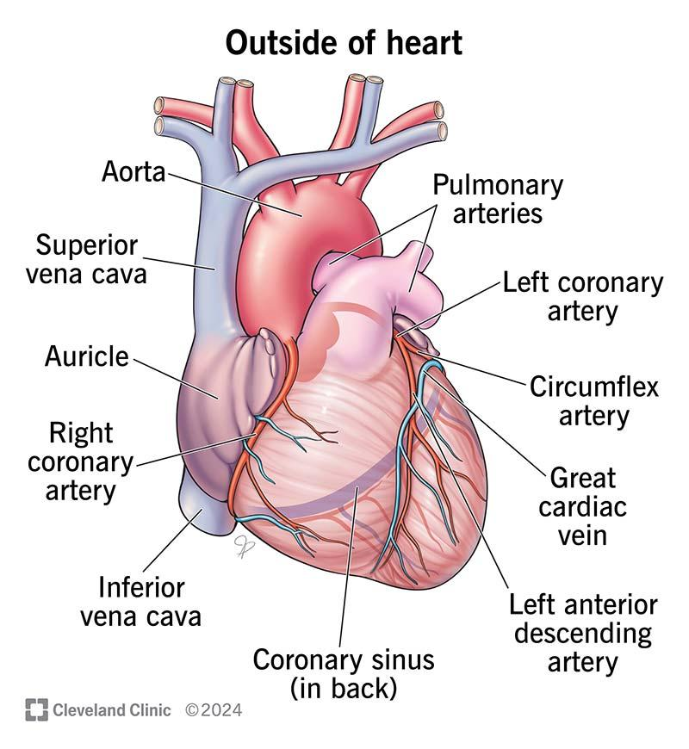
Hypothesis:
To Predict the Heart attack based on Blood Parameters from the data.
Source of Data:
https://www.kaggle.com/datasets/rashikrahmanpritom/heart-attack-analysis-prediction-dataset

Slide 3
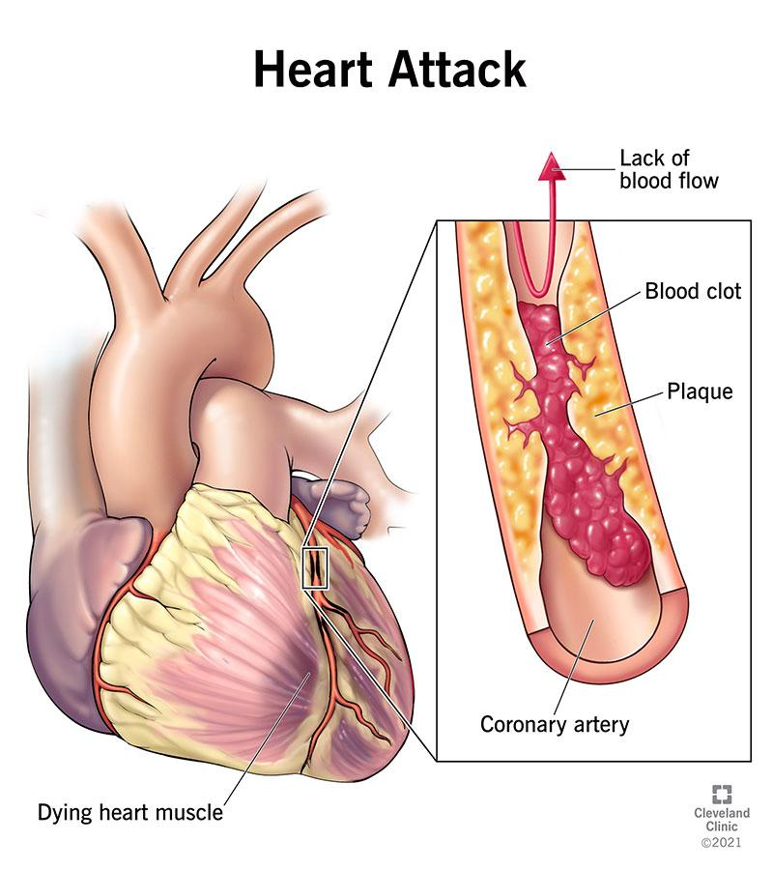
What is Heart Attack:
A heart attack (myocardial infarction) happens when the flow of blood that brings oxygen to a part of your heart muscle suddenly becomes blocked and your heart can't get enough oxygen.
What causes Heart Attack:
smoking.
a high-fat diet.
diabetes.
high cholesterol.
high blood pressure (hypertension)
being overweight or obese.

Slide 4
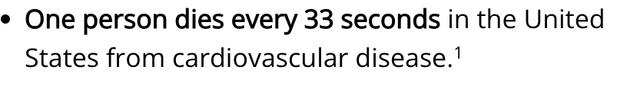

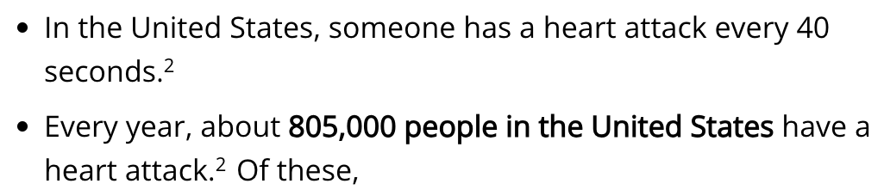
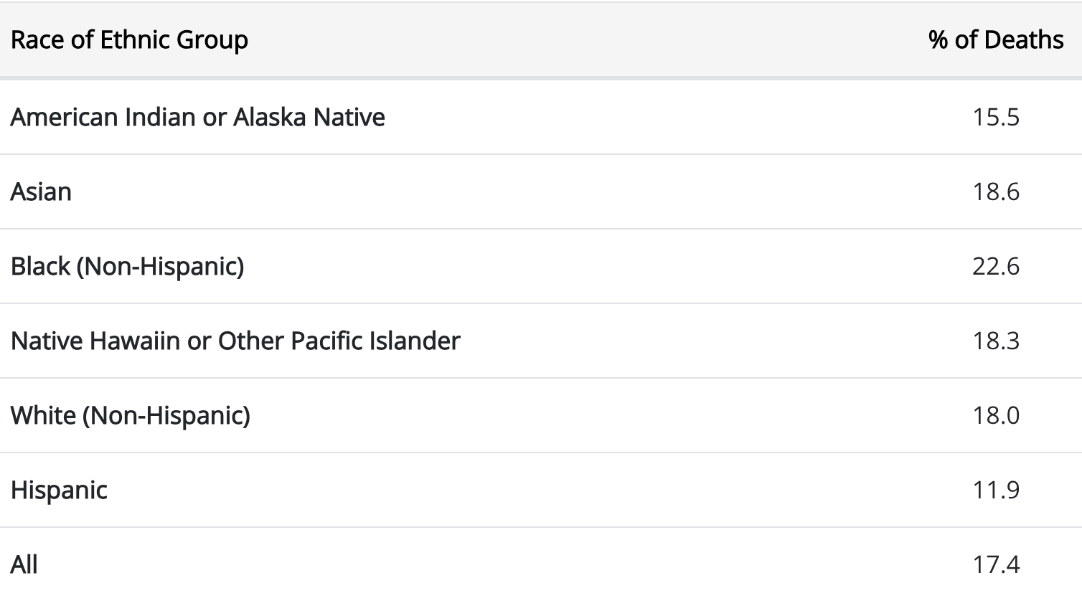
Present Statistics in USA
According to CDC

Slide 5
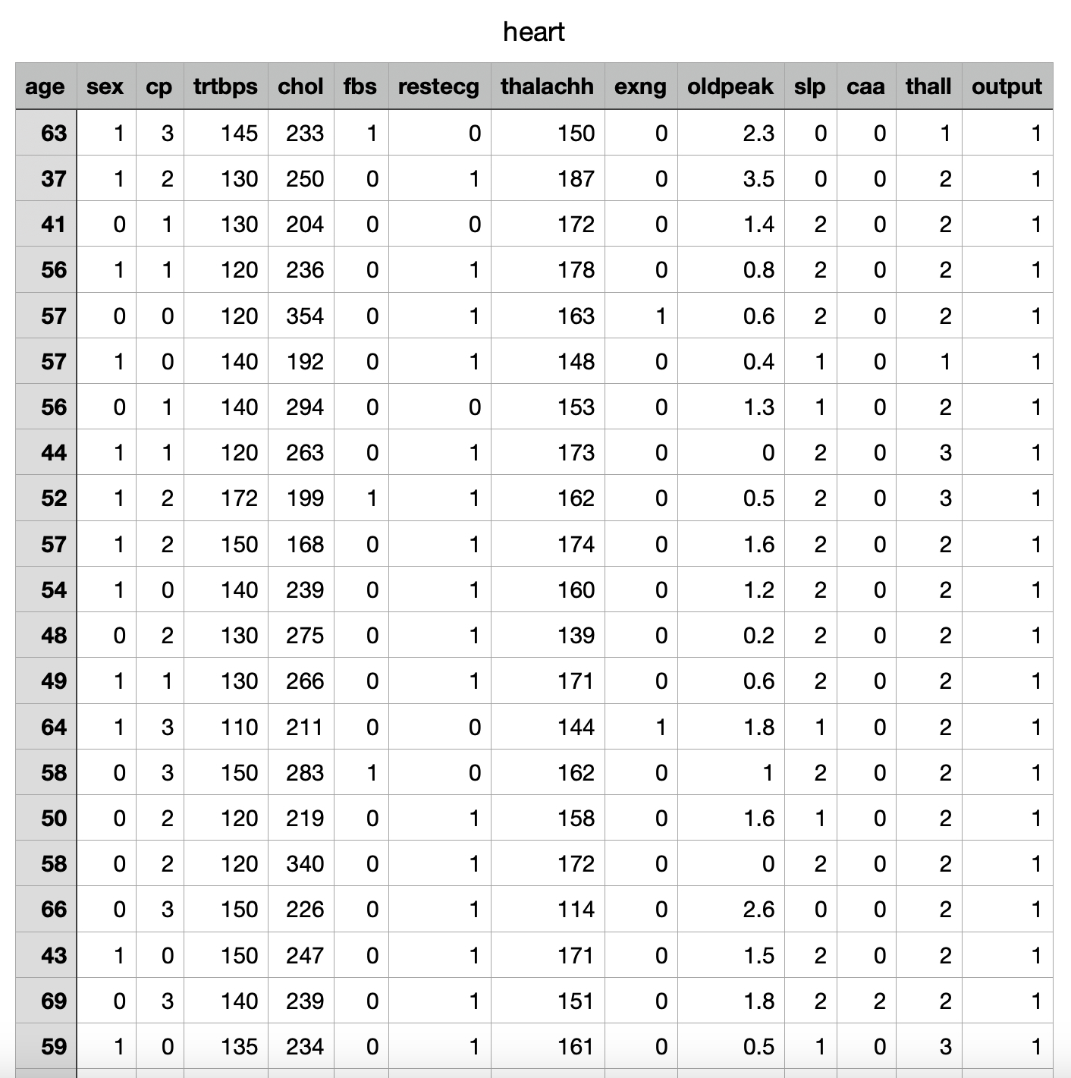
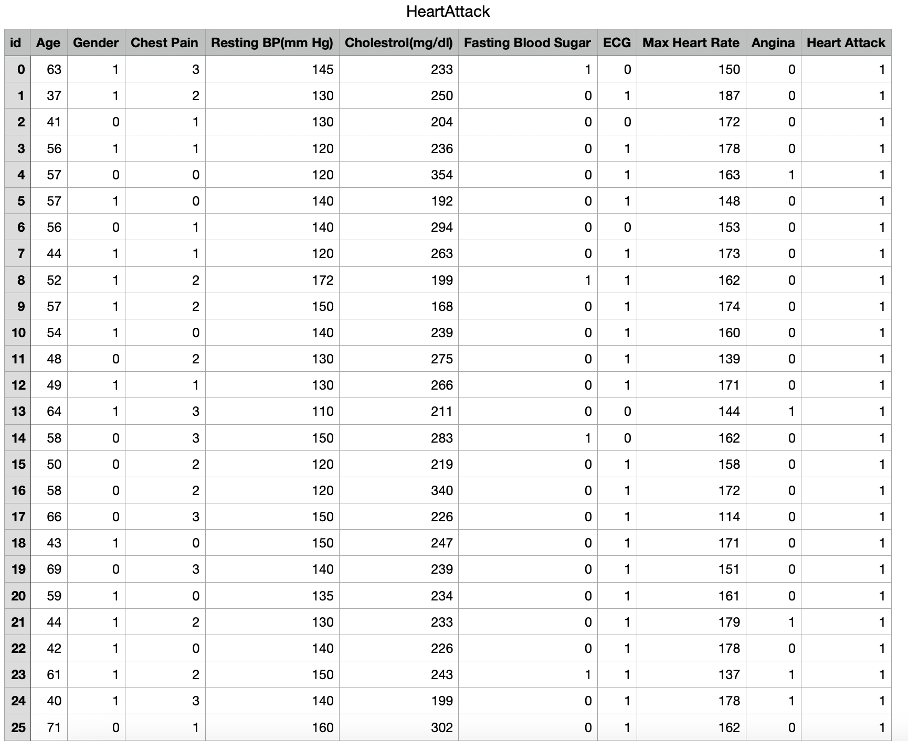
Data Preparation
Raw Data
Cleaned Data

Slide 6
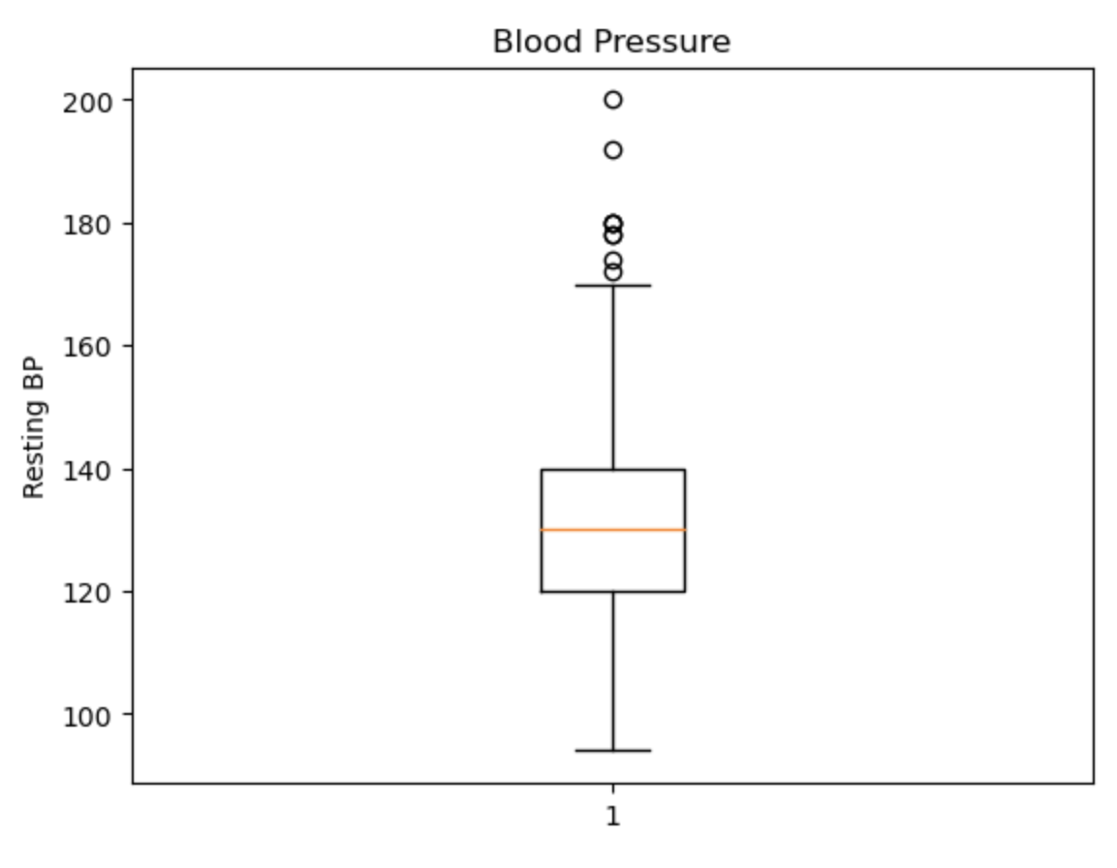
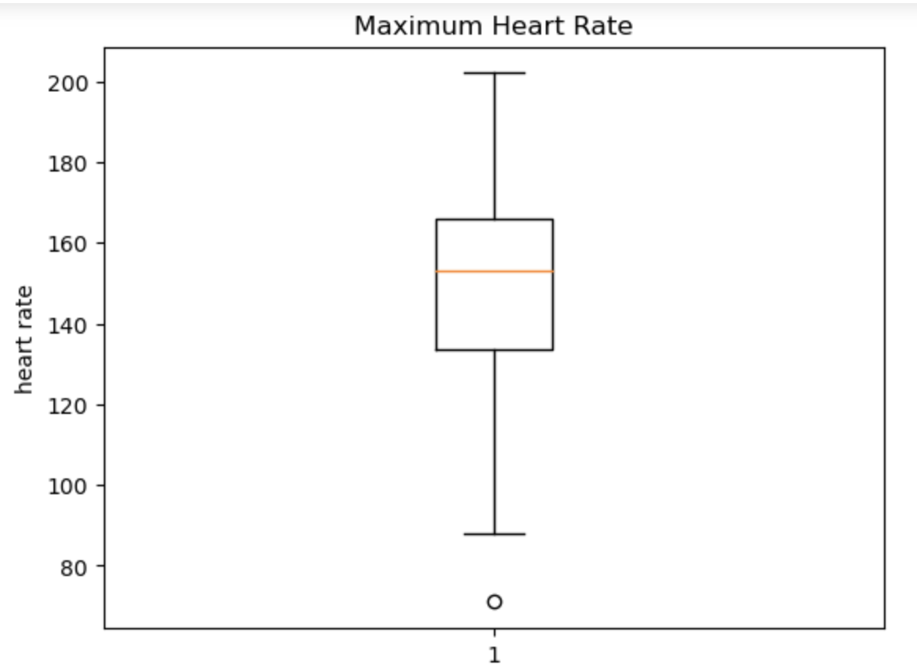
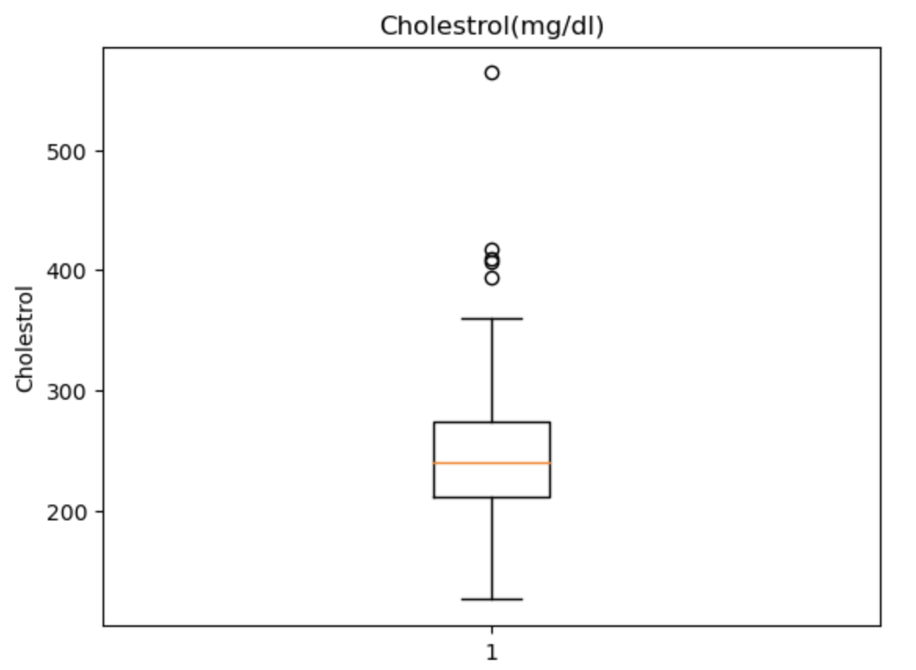
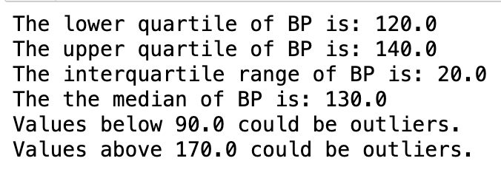
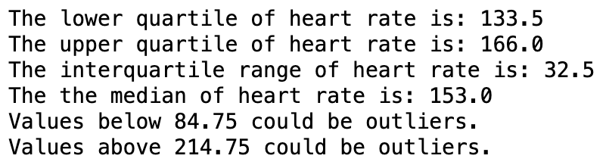
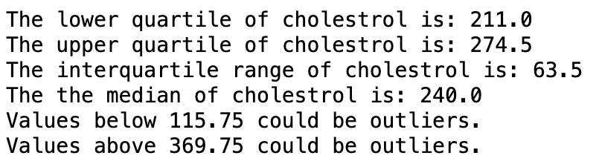
Outlier of The Data

Slide 7
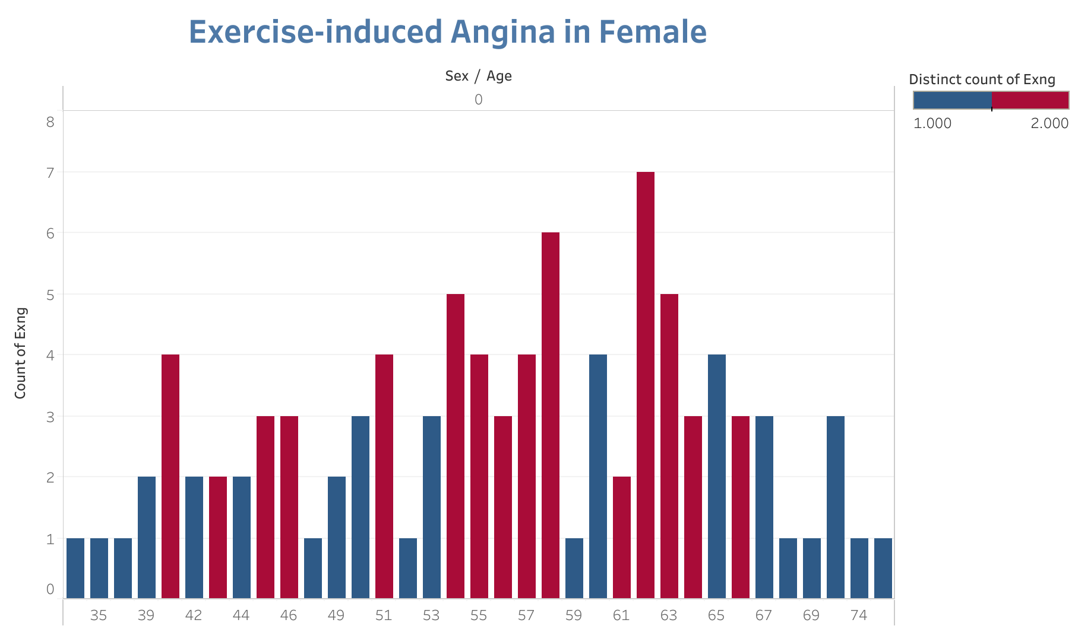
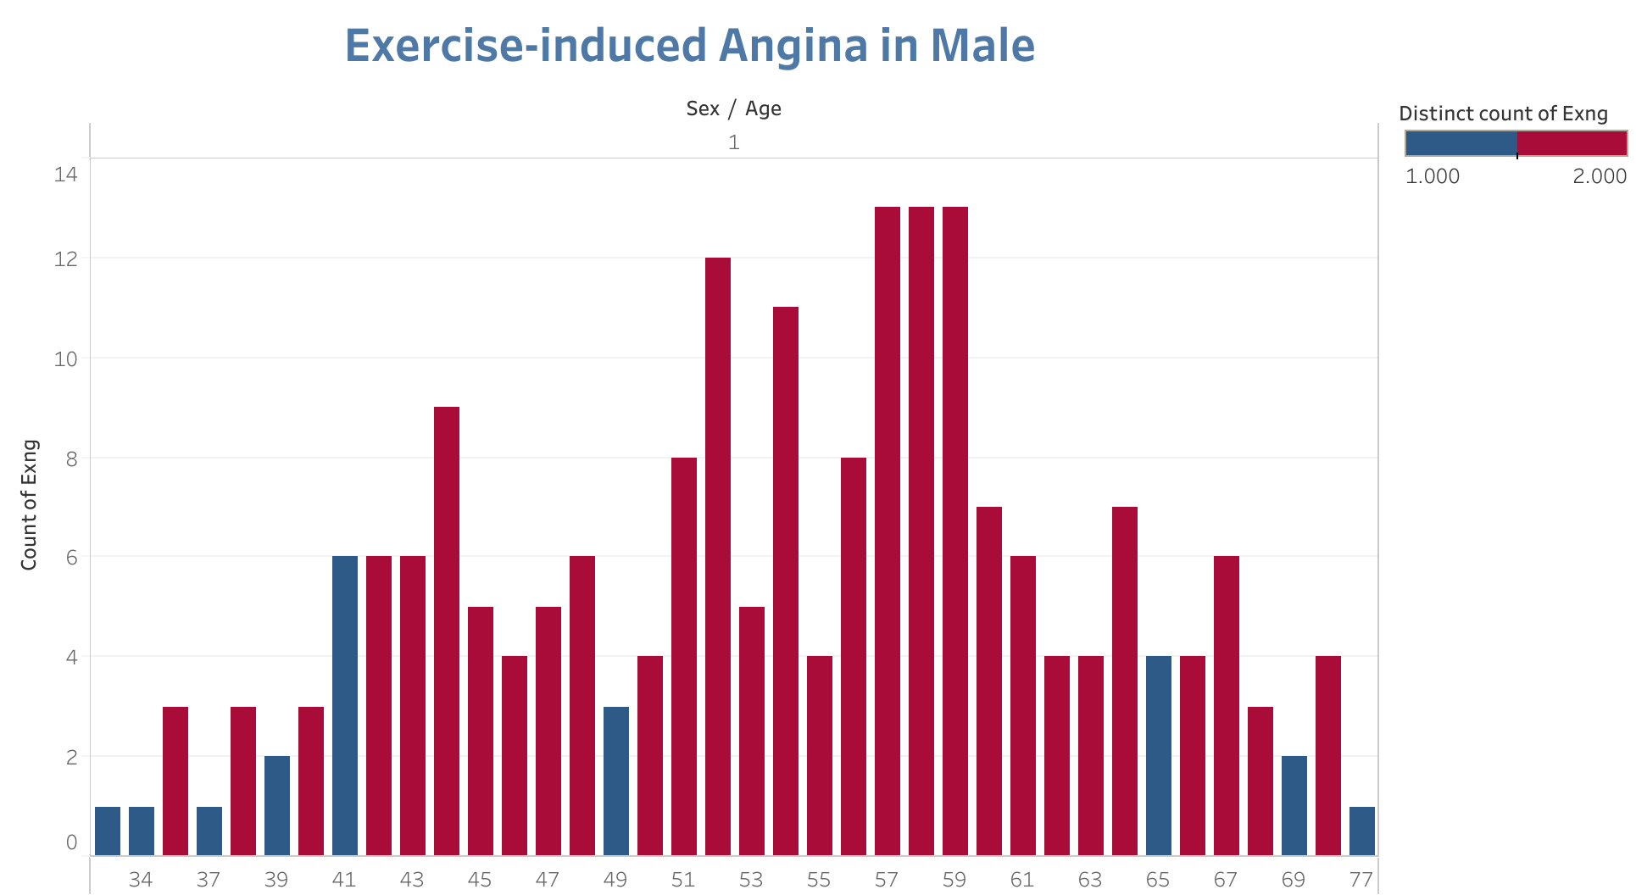

Slide 8
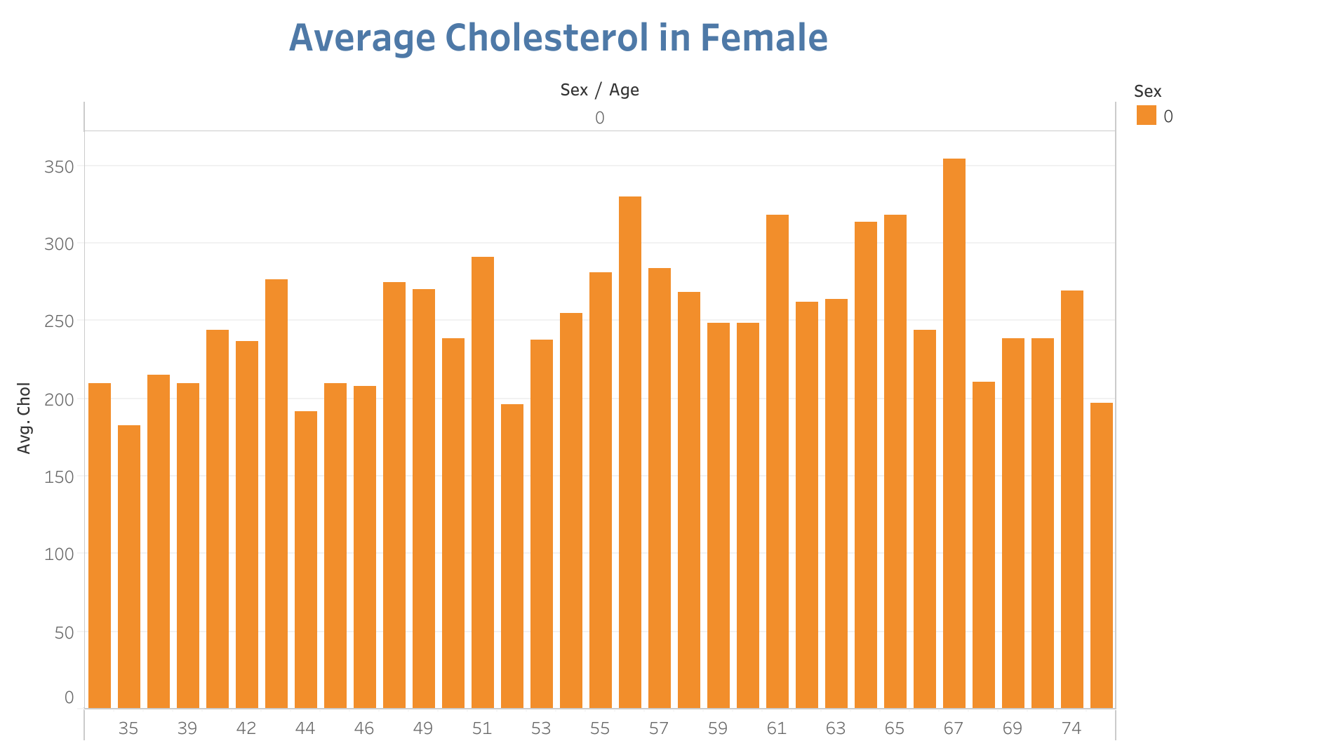
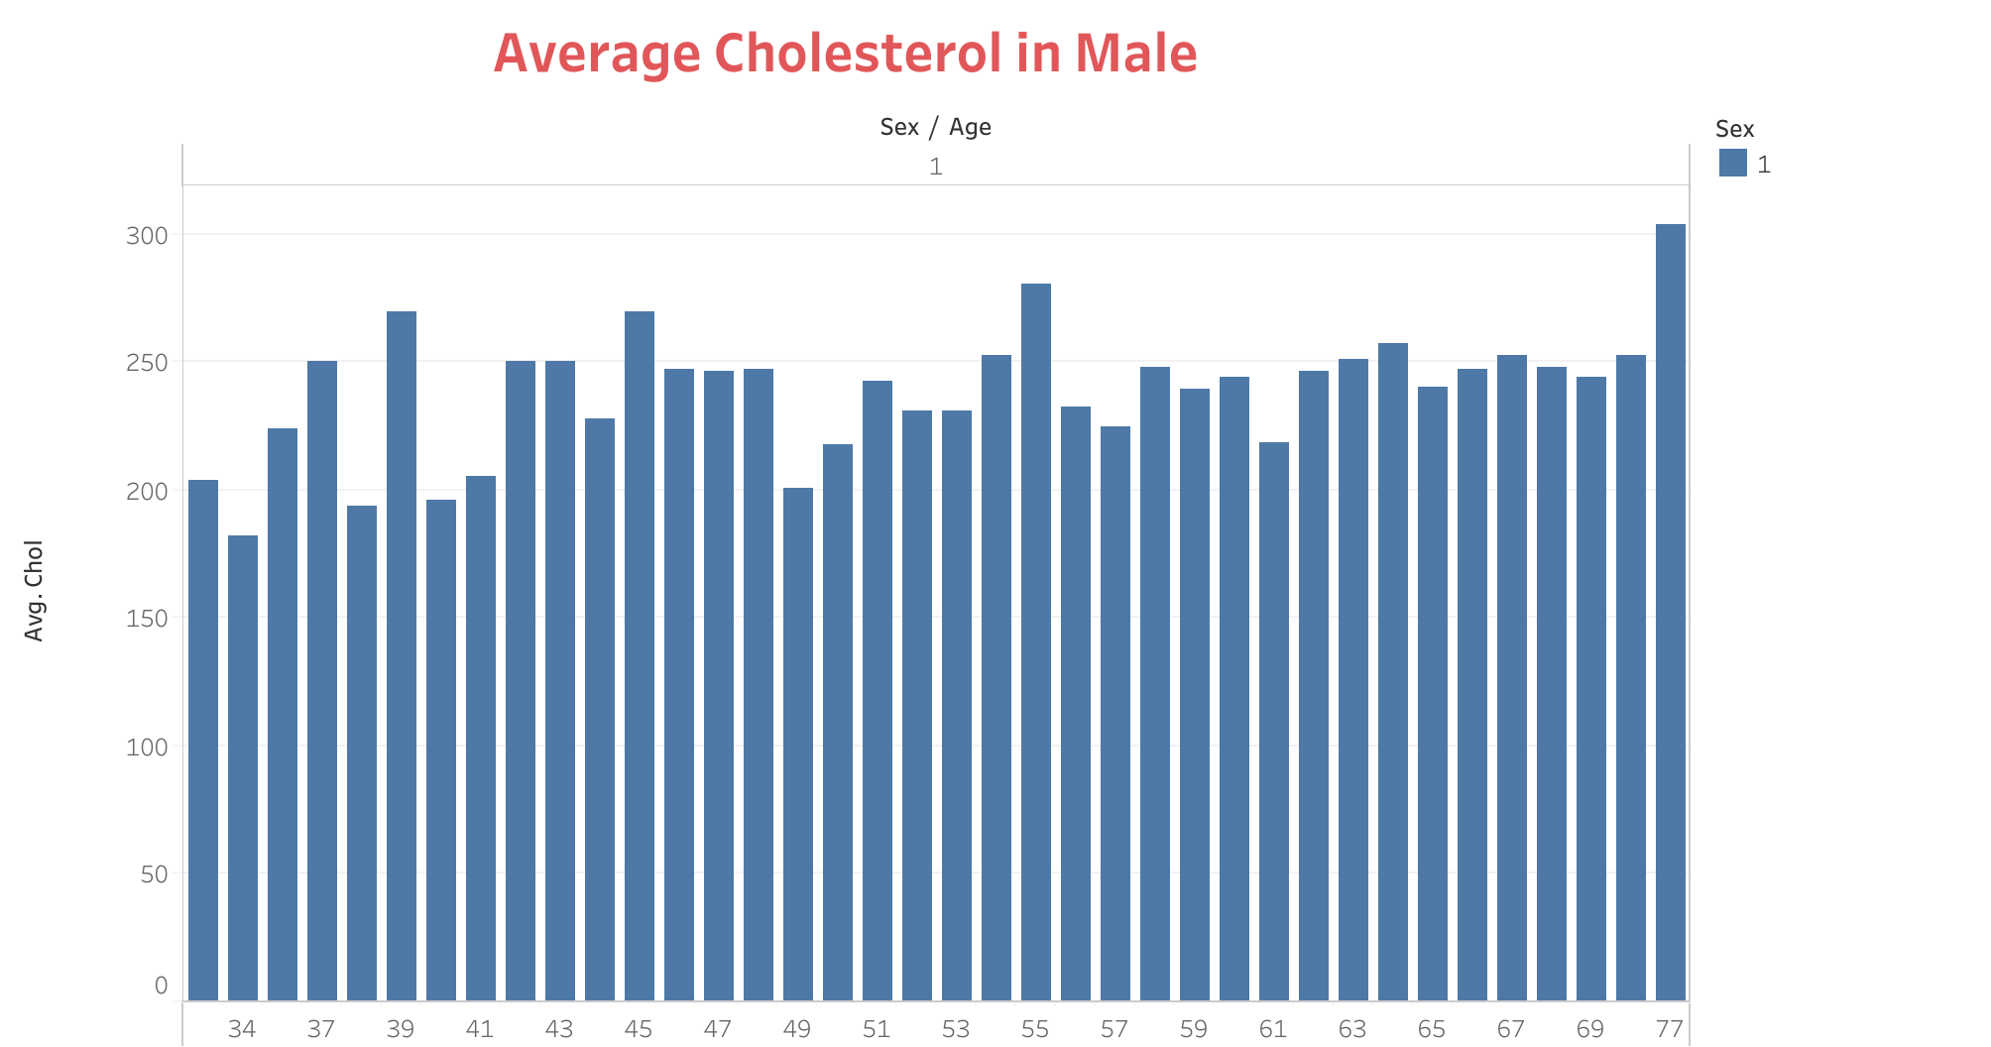

Slide 9
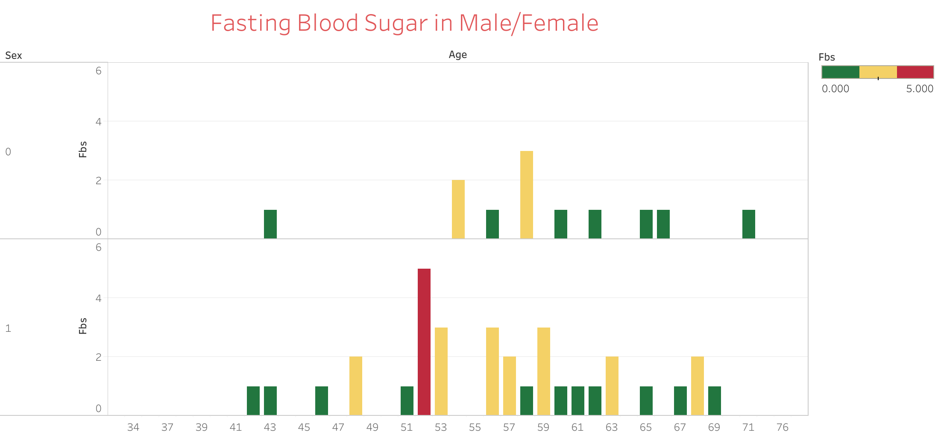

Slide 10
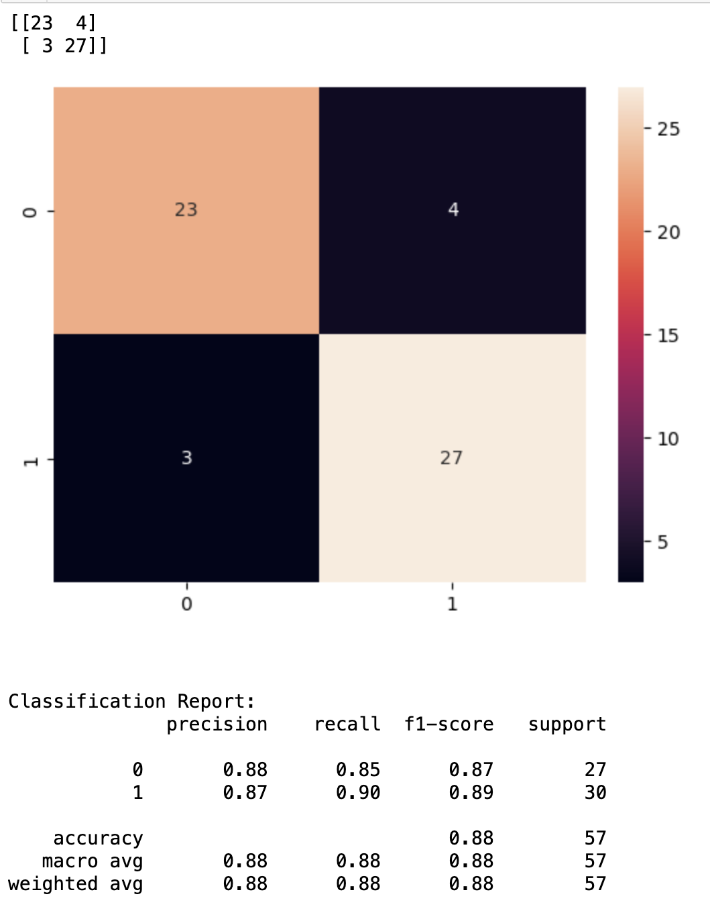
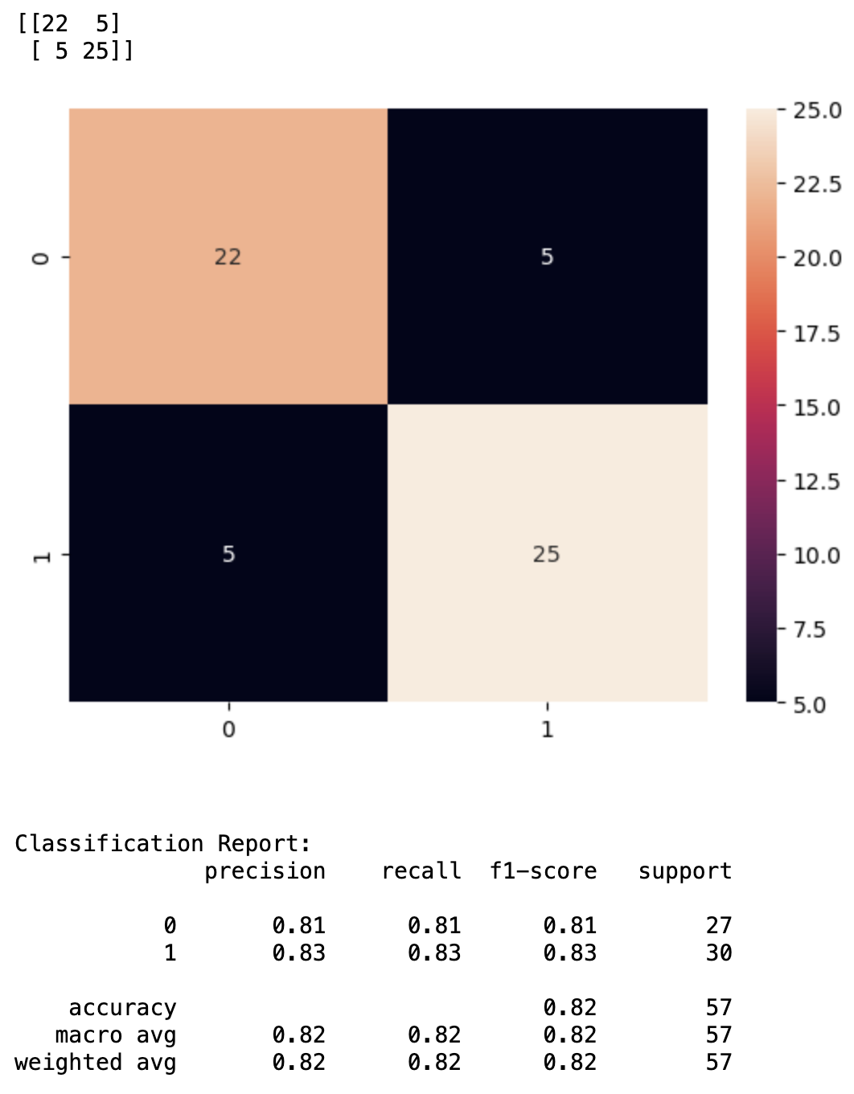
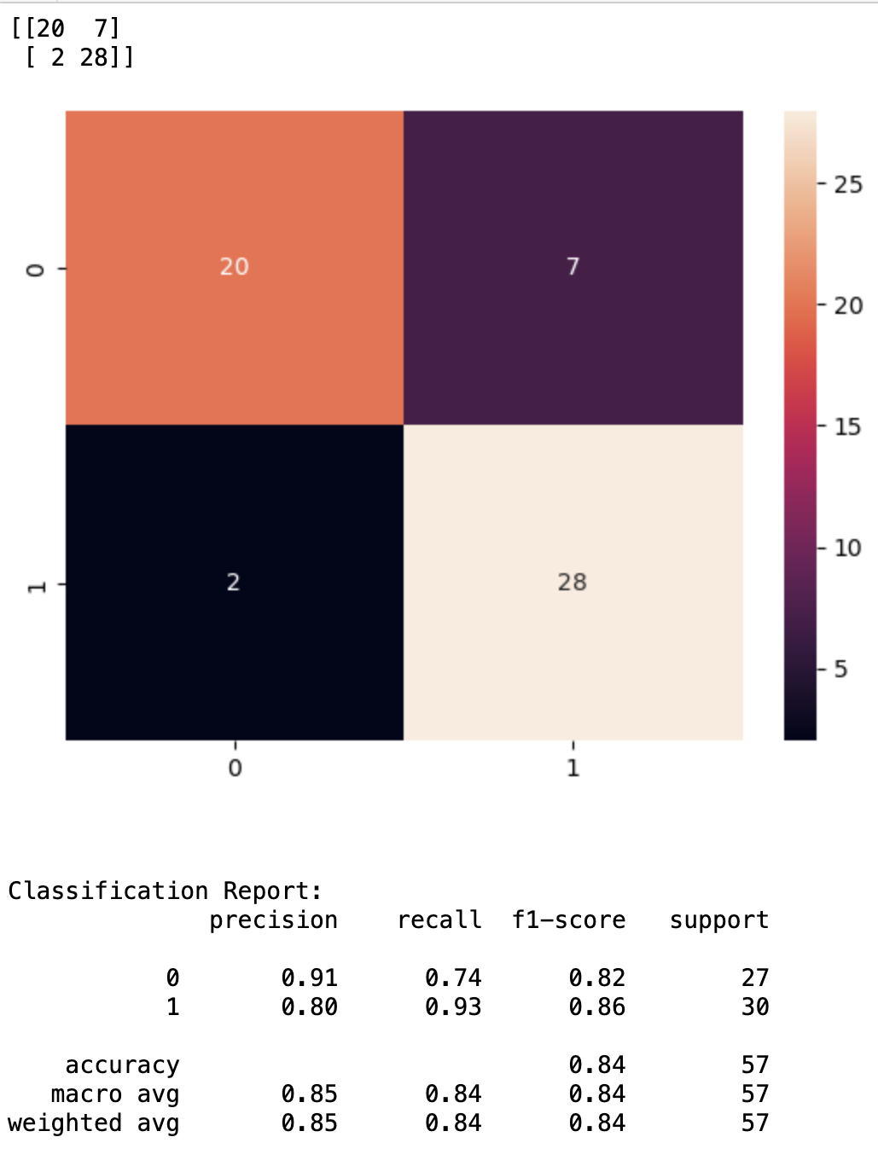
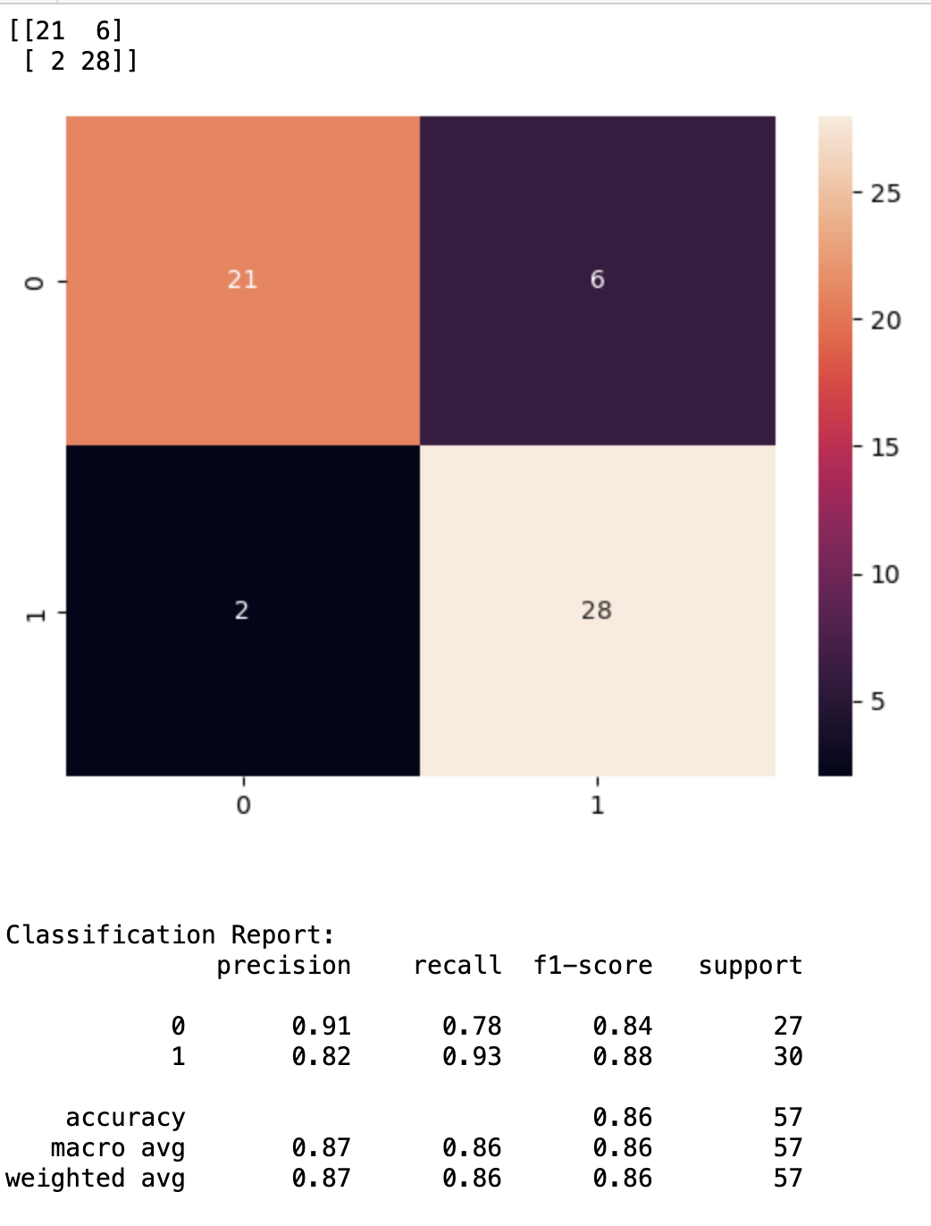
Data Prediction Modeling
Logistic regression
Decision Tree
SVM
Random Forest

Slide 11
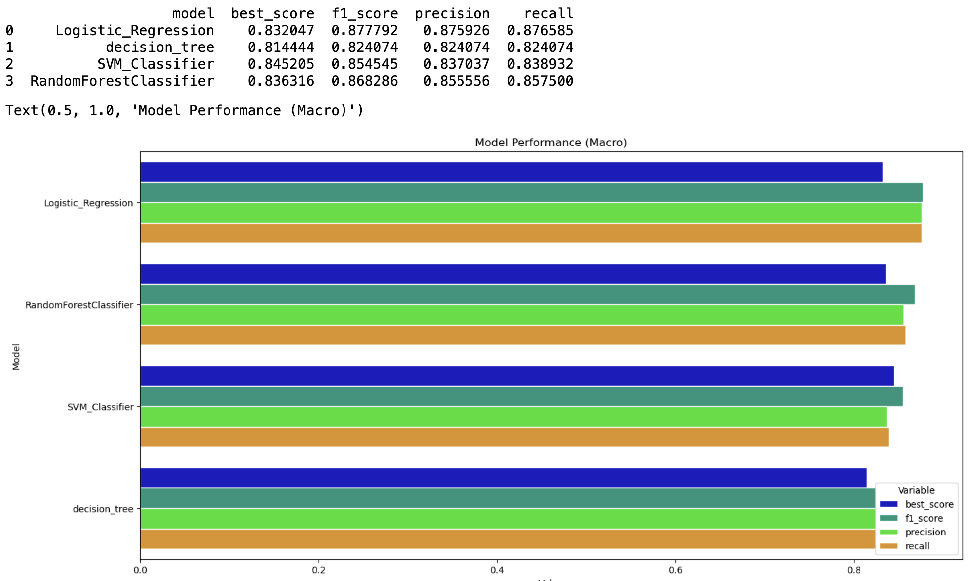
Best Fit Model

Slide 12
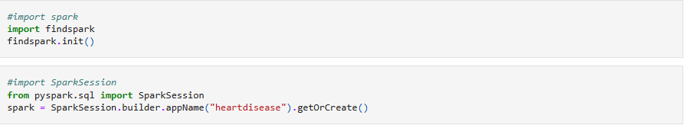
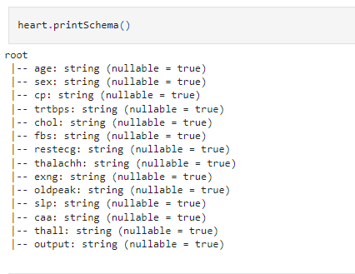
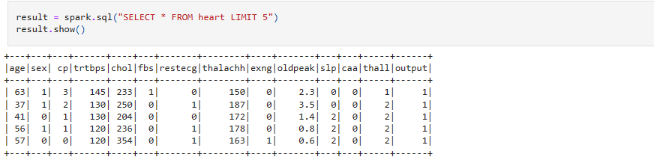
The model utilizes data retrieved from Spark

Slide 13
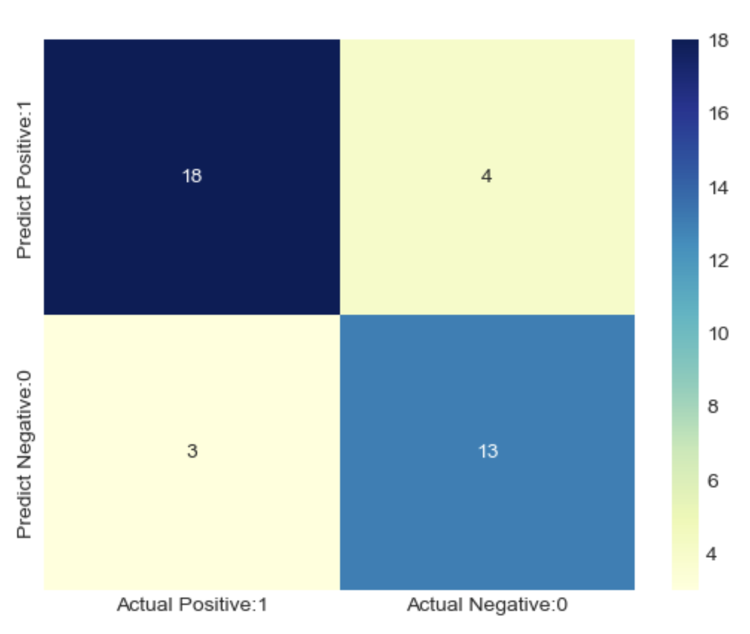
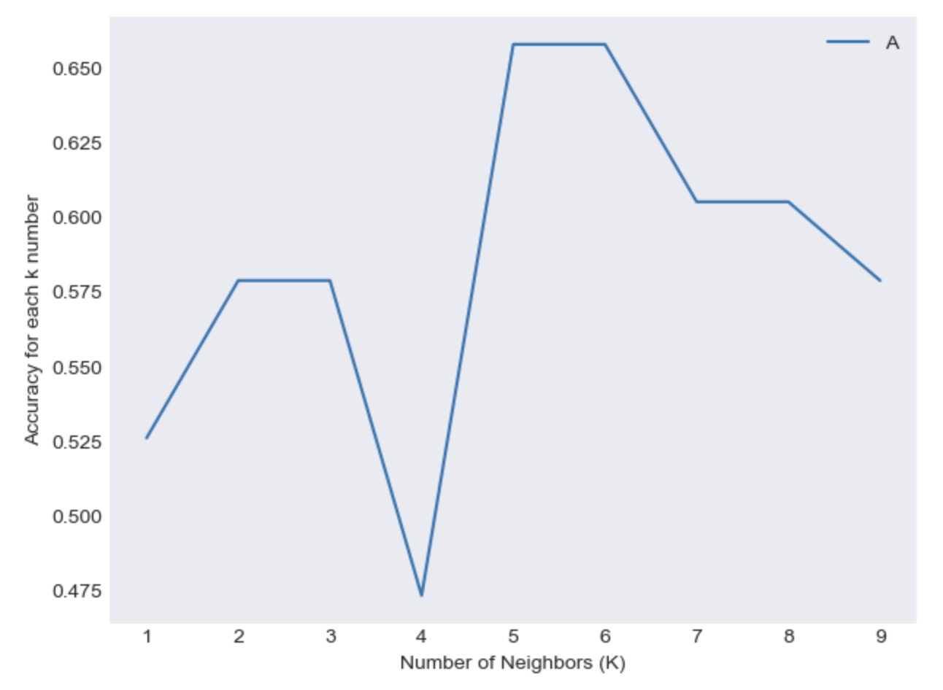
Naive Bayes Method
Confusion matrix
The accuracy score achieved using Naive Bayes is: 81.58 %
True Positives(TP) = 18
True Negatives(TN) = 13
False Positives(FP) = 4
False Negatives(FN) = 3
correct predictions : 18 + 13 = 31
incorrect predictions : 4 + 3 =7
KNeighbors Method
The accuracy score achieved using KNeighbors is: 60.53 %

Slide 14
Conclusion
## Preparing the tools
* (https://pandas.pydata.org/) for data analysis.
* (https://numpy.org/) for numerical operations.
* [Matplotlib](https://matplotlib.org/)/[seaborn](https://seaborn.pydata.org/) for plotting or data visualization.
* [Scikit-Learn](https://scikit-learn.org/stable/) for machine learning modelling and evaluation.
* Data Visualization using Tableau.
We did PCA from unsupervised learning, Logistic Regression, decision Tree and SVM from supervised learning. We also did Naive Bayes and KNN method. After comparing all, we conclude that for this data Decision Tree Model with 92.11% accuracy score and Support vector machine also with 92.11% accuracy score the best Models.
This is not bad, however depending on the context of where this ML pipeline will be utilized, it might be best to sacrifice accuracy in favor of recall or precision optimization. In the event the goal is to provide doctors or patients with a tool to identify heart attack risk in every patient who has a true value of "risk", it might be best to ensure the accuracy is as close to 100% as possible.

Slide 15

While this is a very popular dataset on Kaggle, and served as a great training dataset in a class setting, there was no source or explanation on where the data came from. It could have been either randomly generated or from a single hospital. Fortunately, this was constructed in a classroom setting for educational purposes and not for any real-world healthcare applications. Going forward, assessing the source of datasets before conducting projects or building ML pipelines will be critical.
For further and better understanding of the model and its predictions, we can use more relevant data and merge it with this. We need to use data from around the world and make prediction regarding regions and we can make better predictions for real world.

